Slide 1
Identifying Relations
An Informal Approach

Slide 2
Step 1: Create Relation Database
Married = Spouse = Husband/Wife = Have Kids = Engaged
Plays for = Is Member of = Worked in

Slide 3
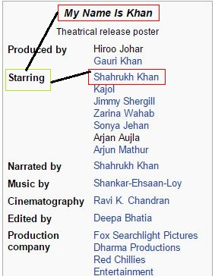
Step 1: Create Relation Database
Wikipedia Infobox
Relation Found
ADD THIS TO DATABASE
Entity_A | Relation | Entity_B
My Name is Khan | Starring | Shahrukh Khan

Slide 4
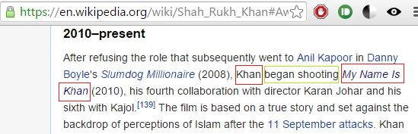
Step 1: Create Relation Database
Entity_A | Relation | Entity_B
My Name is Khan | Starring | Shahrukh Khan
Sentence matching the relation found
Wikipedia Article

Slide 5
Result
Starring = Began Shooting
Now Map this result to a new Table which stores synonyms
And using exiting NLP tools we can also relate Shoot, Shot, Starred

Slide 6
Step 2: Entity & Category Index
Profession
Actor
Writer
Teacher
Lead Actor
Supporting Actor
Movie
Person

Slide 7
Step 3: Query Evaluation
3
Find Base Predicate in the generated Predicate list
Shahrukh Khan
worked in
???
4
1
Insert Movie Name
6
5
Actor x Worked In = Movie Name
Find entity in Entity-Category Gaph
5
2
Categories Graph with Base Predicate as edges
4
Generated Categories: Actor, OwnerOfATeam

Slide 8
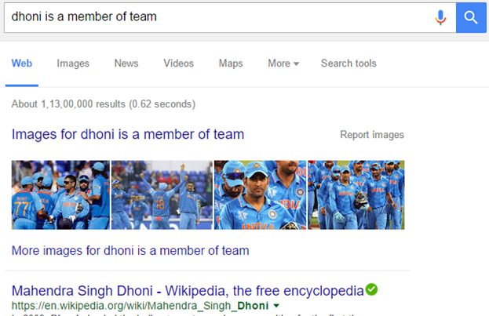
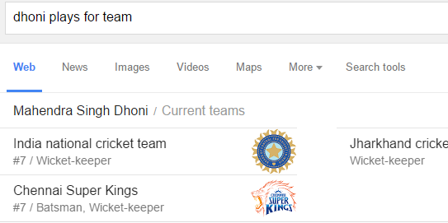
What we aim to do
Make Google understand that these two Queries mean the same thing.

